Slide 1

Optimizing Gym Utilization
Table of contents
Group 6
01
02
Introduction & Problem Statement
Group Fitness Class Utilization
03
04
Gym Equipment Utilization
Key Takeaways & Next Steps

Slide 2
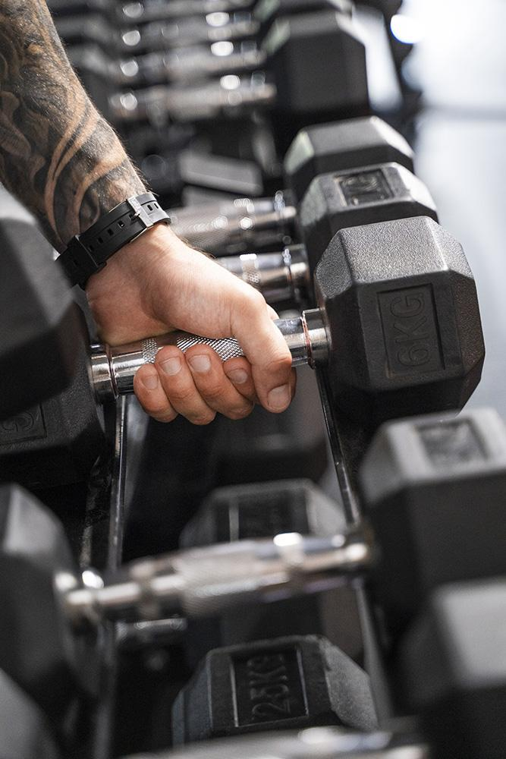
Table of contents
01
02
03
04
Optimizing Gym Utilization
Introduction & Problem Statement
Group Fitness Class Utilization
Group 6
Key Takeaways & Next Steps
Gym Equipment Utilization

Slide 3
01
Introduction & Problem Statement

Slide 4
Introduction
Problem Statement
GoodLife Fitness aims to enhance gym utilization to maximize client satisfaction and profitability.
The company faces two key challenges:
GoodLife Fitness is the largest fitness club chain in Canada, founded in 1979.
It operates over 400 locations across the country.
Provides a wide range of fitness services, including personal training, group fitness classes, and premium gym facilities.
Group Fitness Class Utilization
Gym Equipment Utilization
Some fitness classes are always fully booked but experience low attendance rates
Gym crowd levels fluctuate throughout the day, impacting equipment availability and customer experience

Slide 5
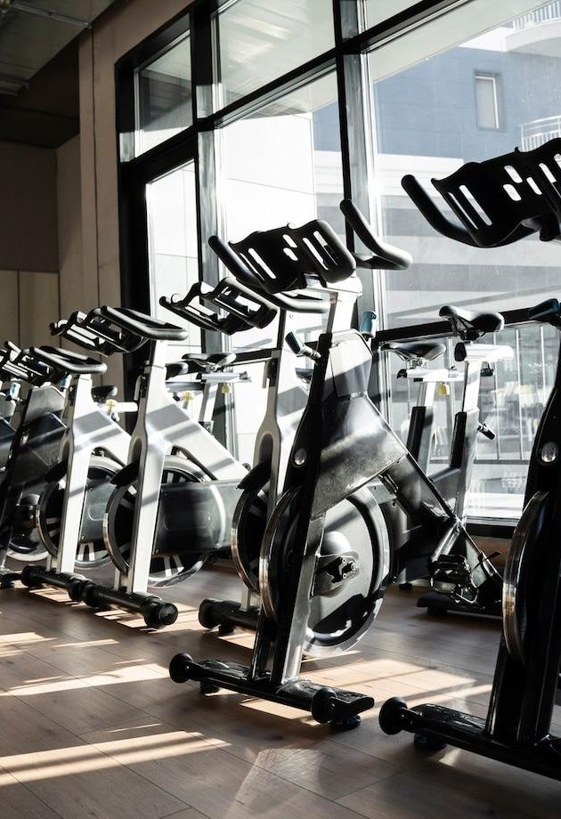
Problem Statement
Introduction
GoodLife Fitness aims to enhance gym utilization to maximize client satisfaction and profitability.
The company faces two key challenges:
02
GoodLife Fitness is the largest fitness club chain in Canada, founded in 1979.
It operates over 400 locations across the country.
Provides a wide range of fitness services, including personal training, group fitness classes, and premium gym facilities.
Group Fitness Class Utilization
Group Fitness Class Utilization
Gym Equipment Utilization
Some fitness classes are always fully booked but experience low attendance rates
Gym crowd levels fluctuate throughout the day, impacting equipment availability and customer experience

Slide 6
02
Group Fitness Class Utilization

Slide 7
Group Fitness Class Utilization
Methodology & Approach
Data Exploration
Feature Engineering
Modeling
Business Integration
Analyze booking data (months_as_member, weight, days_before, etc.)
Check for class imbalances and correlations
Create and transform features
Explore interaction effects between features
Build binary classification models (logistic regression, decision trees, etc.)
Evaluate using metrics like accuracy, precision, recall, and ROC-AUC
Set thresholds on prediction probabilities
Conduct cost-benefit analysis to mitigate false predictions
Objective:
Predict member attendance for booked fitness classes.
Enable dynamic allocation of class capacity.
Why It Matters :
Increase the number of available spots.
Minimize under-utilized class spaces.
Enhance member experience by reducing overcrowding or empty spots.

Slide 8

Methodology & Approach
03
Gym Equipment Utilization
Data Exploration
Feature Engineering
Modeling
Business Integration
Analyze booking data (months_as_member, weight, days_before, etc.)
Check for class imbalances and correlations
Create and transform features
Explore interaction effects between features
Build binary classification models (logistic regression, decision trees, etc.)
Evaluate using metrics like accuracy, precision, recall, and ROC-AUC
Set thresholds on prediction probabilities
Conduct cost-benefit analysis to mitigate false predictions
Group Fitness Class Utilization
Objective:
Predict member attendance for booked fitness classes.
Enable dynamic allocation of class capacity.
Why It Matters :
Increase the number of available spots.
Minimize under-utilized class spaces.
Enhance member experience by reducing overcrowding or empty spots.

Slide 9
03
Gym Equipment Utilization
Methodology & Approach
Data Exploration
Feature Engineering
Modeling
Business Integration
Analyze booking data (months_as_member, weight, days_before, etc.)
Check for class imbalances and correlations
Create and transform features
Explore interaction effects between features
Build binary classification models (logistic regression, decision trees, etc.)
Evaluate using metrics like accuracy, precision, recall, and ROC-AUC
Set thresholds on prediction probabilities
Conduct cost-benefit analysis to mitigate false predictions

Slide 10
Gym Equipment Utilization
Methodology & Approach
Data Exploration
Feature Engineering
Modeling
Business Integration
Visualize attendance patterns and identify trends or seasonality
Evaluate the impact of external factors (temperature, holidays, etc.)
Extract date/time components
Develop lag features to capture temporal dependencies
Regression Models: Linear regression, tree-based methods
Time Series Forecasting: ARIMA/SARIMA or LSTM for temporal dynamics
Inform staffing, maintenance, and targeted promotions based on forecasted crowd levels
Objective:
Predict the number of gym-goers to optimize equipment usage.
Enable proactive management of gym capacity.
Data Elements:
Historical counts (every 10 minutes over the last year)
Additional features: weather, time, holidays, semester info.

Slide 11
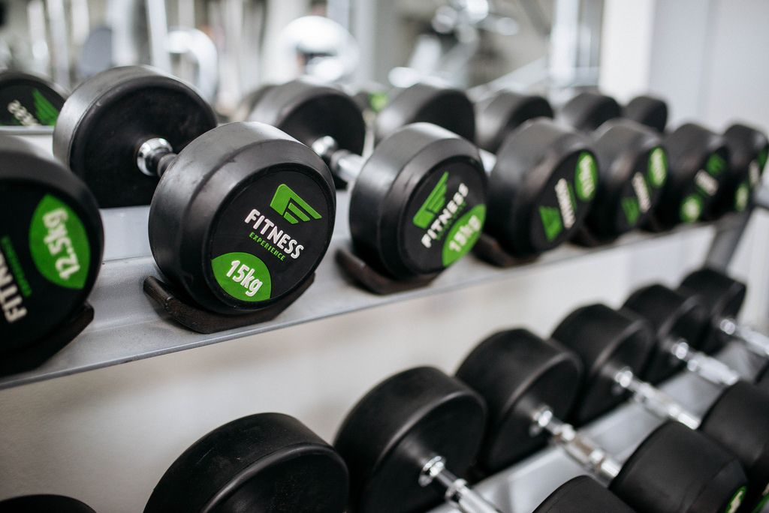
Methodology & Approach
04
Key Takeaways & Next Steps
Data Exploration
Feature Engineering
Modeling
Business Integration
Visualize attendance patterns and identify trends or seasonality
Evaluate the impact of external factors (temperature, holidays, etc.)
Extract date/time components
Develop lag features to capture temporal dependencies
Regression Models: Linear regression, tree-based methods
Time Series Forecasting: ARIMA/SARIMA or LSTM for temporal dynamics
Inform staffing, maintenance, and targeted promotions based on forecasted crowd levels
Gym Equipment Utilization
Objective:
Predict the number of gym-goers to optimize equipment usage.
Enable proactive management of gym capacity.
Data Elements:
Historical counts (every 10 minutes over the last year)
Additional features: weather, time, holidays, semester info.

Slide 12
04
Key Takeaways & Next Steps

Slide 13
Key Takeaways & Next Steps
Key Takeaways:
Data-driven approach can help optimize capacity and enhance customer satisfaction.
Predictive models can support dynamic resource allocation in both group classes and gym equipment usage.
Next Steps:
Refine data preprocessing and feature engineering.
Test and validate multiple modeling approaches.
Integrate predictive models into GoodLife’s operational systems.
Continuously update models with new data for sustained performance.
Thanks!

Slide 14
Thanks!
Key Takeaways & Next Steps
Key Takeaways:
Data-driven approach can help optimize capacity and enhance customer satisfaction.
Predictive models can support dynamic resource allocation in both group classes and gym equipment usage.
Next Steps:
Refine data preprocessing and feature engineering.
Test and validate multiple modeling approaches.
Integrate predictive models into GoodLife’s operational systems.
Continuously update models with new data for sustained performance.

